Slide 1
An Introduction to Database
Introduction to Database for Undergraduate Study
Lecture 8
Set Operators
Comparison Operators
Between/In
This lecture and its associated materials have been produced by Mr. Rohit Panday (M.Sc. IT, 10+ Years of Industry/Academic Experience) of iAcademy for the purposes of lecturing on the above described subject and the material should be viewed in this context. The work does not constitute professional advice and no warranties are made regarding the information presented. The Author and iAcademy do not accept any liability for the consequences of any action taken as a result of the work or any recommendations made or inferred. Permission to use any of these materials must be first granted by iAcademy.

Slide 2

OPERATORS
An operator is a reserved word or a character used primarily in an SQL statement's WHERE clause to perform operation(s)

Slide 3
Operators in SQL
Arithmetic Operators
+, -, *, /, %
Comparison Operators
=,<>,<=,>=, !=, <, >
Logical
Operators
AND, BETWEEN, IN, NOT, LIKE
Set
Operators
UNION, INTERSECT

Slide 4
Arithmetic Operators - Addition
Example | SELECT SALARY + BONUS FROM EMPLOYEE_PAY_TBL;
Meaning | The SALARY column is added with the BONUS column for a total for each row of data

Slide 5
Arithmetic Operators - Subtraction
Example | SELECT SALARY - BONUS FROM EMPLOYEE_PAY_TBL;
Meaning | The BONUS column is subtracted from the SALARY column for a total for each row of data

Slide 6
Arithmetic Operators - Multiplication
Example | SELECT SALARY * 12 FROM EMPLOYEE_PAY_TBL;
Meaning | The SALARY column is multiplied by 12

Slide 7
Arithmetic Operators - Division
Example | SELECT SALARY / 10 FROM EMPLOYEE_PAY_TBL;
Meaning | The SALARY column is divided by 10

Slide 8
Comparison Operators
Operator | Description | Example
= | Checks if the values of two operands are equal or not, if yes then condition becomes true. | (a = b) is not true.
!= | Checks if the values of two operands are equal or not, if values are not equal then condition becomes true. | (a != b) is true.
<> | Checks if the values of two operands are equal or not, if values are not equal then condition becomes true. | (a <> b) is true.
> | Checks if the value of left operand is greater than the value of right operand, if yes then condition becomes true. | (a > b) is not true.
< | Checks if the value of left operand is less than the value of right operand, if yes then condition becomes true. | (a < b) is true.

Slide 9
Comparison Operators
Operator | Description | Example
>= | Checks if the value of left operand is greater than or equal to the value of right operand, if yes then condition becomes true. | (a >= b) is not true.
<= | Checks if the value of left operand is less than or equal to the value of right operand, if yes then condition becomes true. | (a <= b) is true.
!< | Checks if the value of left operand is not less than the value of right operand, if yes then condition becomes true. | (a !< b) is false.
!> | Checks if the value of left operand is not greater than the value of right operand, if yes then condition becomes true. | (a !> b) is true.

Slide 10
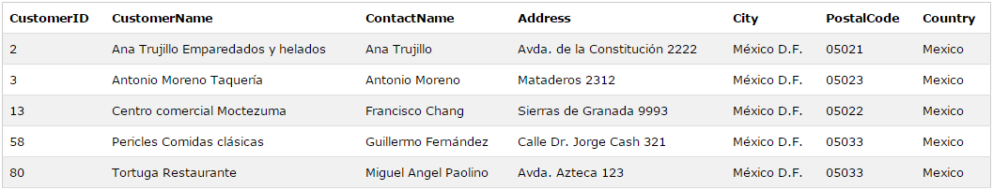
Comparison Operator - Example
Example | SELECT * FROM Customers WHERE Country='Mexico';
Result

Slide 11
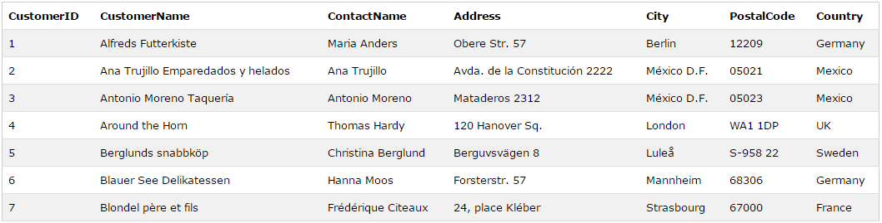
Comparison Operator - Example
Example | SELECT * FROM Customers WHERE CustomerID<=7;
Result

Slide 12
Logical Operators
Operators | Description
AND | The AND operator allows the existence of multiple conditions in an SQL statement's WHERE clause.
BETWEEN | The BETWEEN operator is used to search for values that are within a set of values, given the minimum value and the maximum value.
IN | The IN operator is used to compare a value to a list of literal values that have been specified.
LIKE | The LIKE operator is used to compare a value to similar values using wildcard operators.
NOT | The NOT operator reverses the meaning of the logical operator with which it is used. Eg: NOT EXISTS, NOT BETWEEN, NOT IN, etc. This is a negate operator.

Slide 13
Logical Operator – AND
Example | SELECT * FROM Customers WHERE Country='Germany‘ AND City='Berlin';
Result
AND operator - if both the first condition AND the second condition are true.

Slide 14
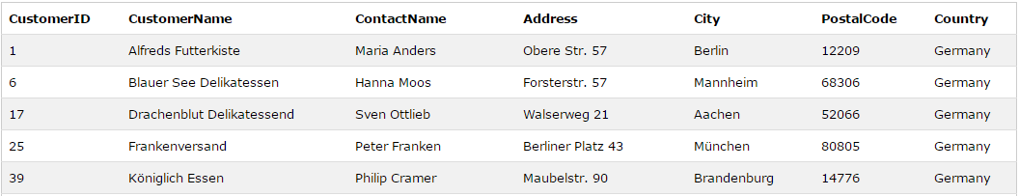
Logical Operator – OR
Example | SELECT * FROM Customers WHERE Country='Germany‘ OR City='Berlin';
Result
AND operator - if both the first condition OR the second condition are true.

Slide 15
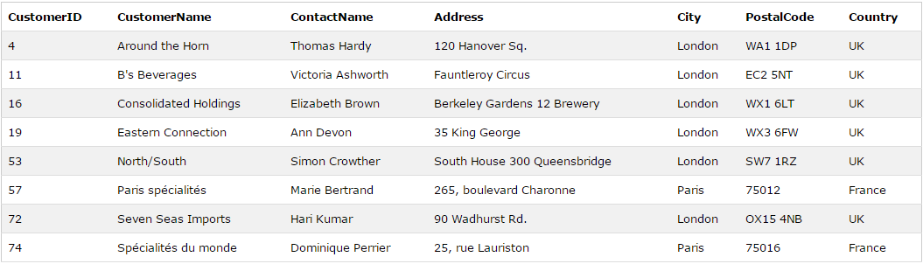
Logical Operator – IN
Syntax | SELECT column_name(s) FROM table_name WHERE column_name IN (value1,value2,...);
Example | SELECT * FROM Customers WHERE City IN ('Paris', 'London');
The IN operator allows you to specify multiple values in a WHERE clause.

Slide 16
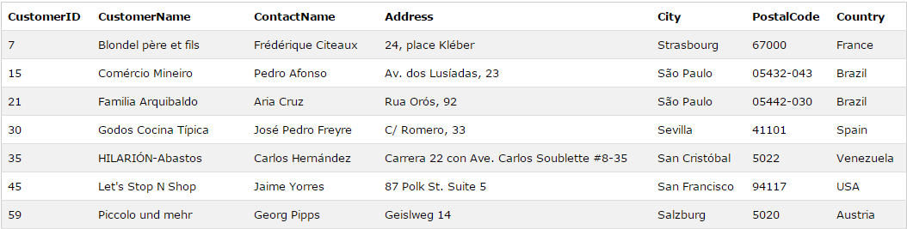
Logical Operator – LIKE
Syntax | SELECT column_name(s) FROM table_name WHERE column_name LIKE pattern;
Example | SELECT * FROM Customers WHERE City LIKE 's%';
The LIKE operator is used in a WHERE clause to search for a specified pattern

Slide 17
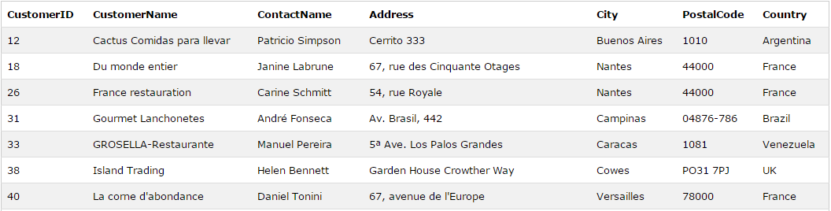
Logical Operator – LIKE
Syntax | SELECT column_name(s) FROM table_name WHERE column_name LIKE pattern;
Example | SELECT * FROM Customers WHERE City LIKE '%s';
The LIKE operator is used in a WHERE clause to search for a specified pattern

Slide 18
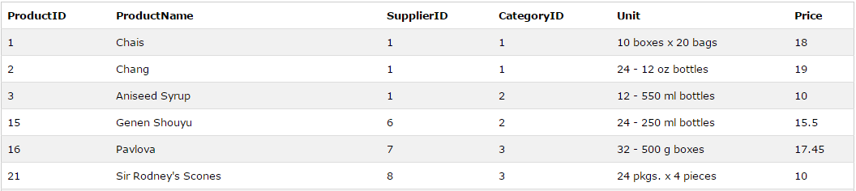
Logical Operator – BETWEEN
Syntax | SELECT column_name(s) FROM table_name WHERE column_name BETWEEN value1 AND value2;
Example | SELECT * FROM Products WHERE Price BETWEEN 10 AND 20;
The BETWEEN operator selects values within a range. The values can be numbers, text, or dates.

Slide 19
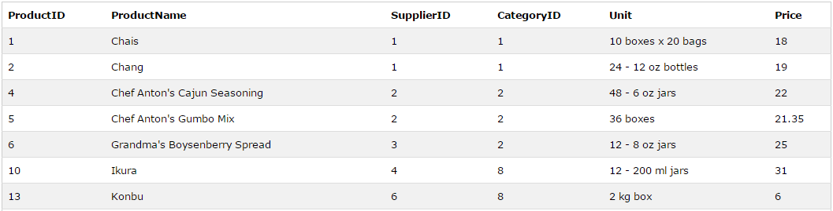
Logical Operator – BETWEEN
Syntax | SELECT column_name(s) FROM table_name WHERE column_name BETWEEN value1 AND value2;
Example | SELECT * FROM Products WHERE ProductName BETWEEN 'C' AND 'M';
The BETWEEN operator selects values within a range. The values can be numbers, text, or dates.

Slide 20
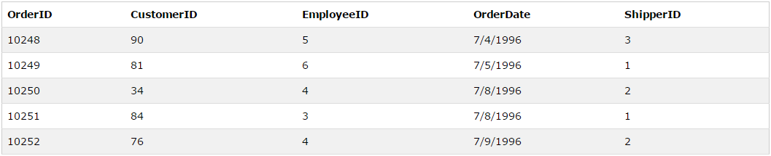
Logical Operator – BETWEEN
Syntax | SELECT column_name(s) FROM table_name WHERE column_name BETWEEN value1 AND value2;
Example | SELECT * FROM Orders WHERE OrderDate BETWEEN #07/04/1996# AND #07/09/1996#;
The BETWEEN operator selects values within a range. The values can be numbers, text, or dates.

Slide 21
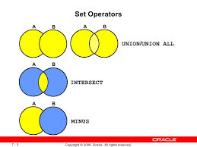
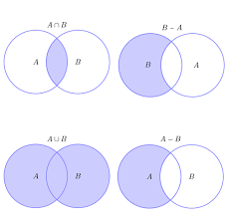
SET Operators

Slide 22
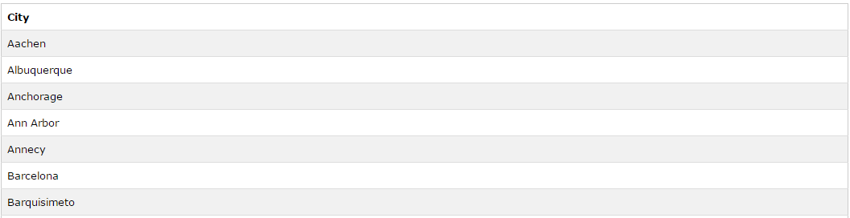
Set Operator – UNION
Syntax | SELECT column_name(s) FROM table1 UNION SELECT column_name(s) FROM table2;
Example | SELECT City FROM Customers UNION SELECT City FROM Suppliers ORDER BY City;
The BETWEEN operator selects values within a range. The values can be nu

Slide 23
Key Points

Slide 24

Laugh

Slide 25

End of Lecture for Week - 8

